Slide 1
ICONIX
Naughty Squirrels
By Alexandru-Flaviu Orban, Flavio Fiori, James Coyle, Sean Khanna and Xavier Oliver

Slide 2
What is the purpose of ICONIX?

Slide 3
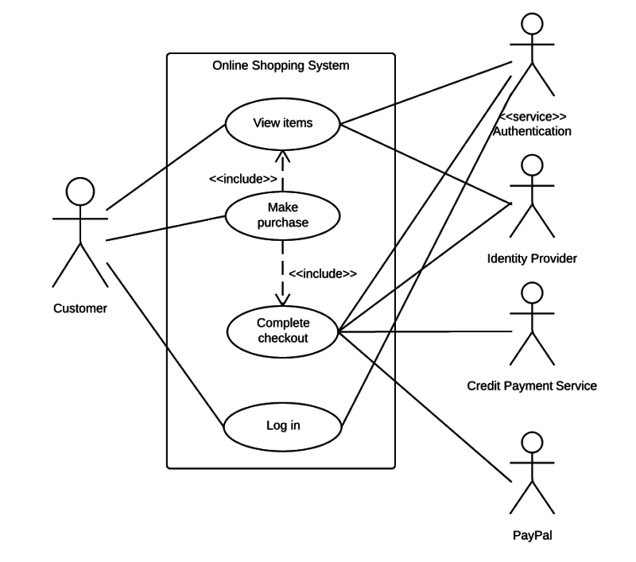

ICONIX Purpose
Notes:
Lucidchart, 2019. When to apply use case diagrams [viewed 30/01/2019]. Available at: https://www.lucidchart.com/pages/uml-use-case-diagram?a=1
Mort, A., 2019. 10 Things Healthy Introverts and Sensitive Types Do Differently [viewed 30/01/2019]. Available at: https://www.andymort.com/minimalist-mentality/

Slide 4

Analysis
Design
Notes:
Void Png 6 [viewed 30/01/2019]. Available at: https://pngimage.net/void-png-6/

Slide 5
Benefits in change
Adjustment
Swift
Impact

Slide 6


Slide 7
What are the ICONIX phases?
XAVIER

Slide 8
How the phases work with Agile sprints?
FIORI

Slide 9
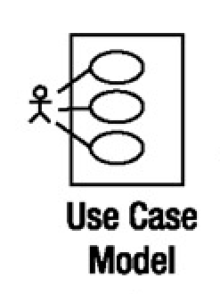
The ICONIX process helps reduce the amount of sprints by gathering the exact requirements from the start.
This is done in the Use Case Model.
Notes:
Iconix Process
https://www.red-gate.com/simple-talk/opinion/opinion-pieces/agile-development-and-iconix/

Slide 10
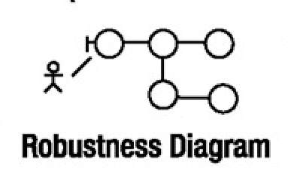
The robustness analysis finds potential errors that were made in the case model, providing the developers something to show to the customer and verifying that the requirements which were set at the start of each iteration were correct, otherwise they can be corrected if they differ from the stakeholders vision.

Slide 11
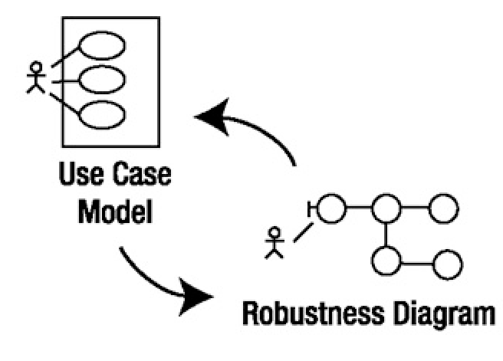
If the requirements differ from the stakeholder vision a new iteration has to me made.
Notes:
In between each iteration a robustness analysis is conducted.

Slide 12
The goals of each phase and milestone requirements to proceed into the next
FIORI

Slide 13
How does ICONIX relate to Behaviour Driven Development?
JAMES

Slide 14
Behaviour Driven Development
Derived from Test-Driven Development
Enables questions like
Where to start the process
What to test and not to test
What to call the test
This allows much better communication with Stakeholders (clients, business executives & project members, etc.)
Allows business-readable language to describe system behaviour without explaining how that behaviour is implemented
Notes:
Behaviour Driven Development, its development was derived from Test-Driven Development in order to answer questions such as
“Where to start the process?”
“What to test and what not to test”
“What to call the tests?”
It enables business-readable language which allows you to describe a system’s behaviour without explaining how that behaviour is implemented.
It essentially dumbs down the design process to allow everyone to fully understand how their requirements have been catered for.
https://medium.com/@TechMagic/get-started-with-behavior-driven-development-ecdca40e827b

Slide 15
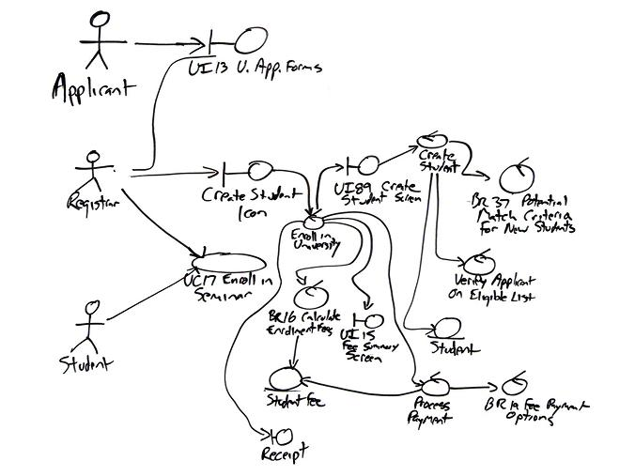
How does it relate to Iconix?
Iconix is about understanding and documenting the user’s behaviour requirements using analysis and using this to create clean object orientated system designs
Iconix uses robustness analysis, which allows all parties to get a good understanding of the user’s involvement from different perspectives
Much like Behaviour Driven Development it ensures that all parties (software developers, project managers and other stakeholders) can easily see how the design fulfils their requirements and whether a re-design will be necessary with minimal design time.
Example Robustness Analysis Diagram
Notes:
It’s about understanding and documenting the user’s behaviour requirements, rooting out ambiguity in these requirements, and then using them to drive a good clean object orientated design.
(example) Iconix uses robustness analysis, which is essentially a slightly altered UML diagram with a low-level view which shows how end-user behaviour from various actors have been taken into consideration, as you can see from the diagram,
(next slide) It allows all parties to visibly see exactly how their requirements have been placed in the design of the software, it also allows the development team to design aspects of the software in terms of data flow and functionality which are high enough level as to not to confuse the situation or stakeholders and get the best return from requirement collection as possible.
https://www.red-gate.com/simple-talk/opinion/opinion-pieces/agile-development-and-iconix/

Slide 16
The ICONIX Process is a minimalist one, it uses a multitude of case driven modelling processes that are well suited for agile Java development, these processes also use a core subset of UML diagrams. Since the process is a minimalist one, it works well together with test-driven development (TDD).
The trick behind the ICONIX Process is about understand and documenting the user’s behavior requirements, eliminating ambiguity and then using them to create a clean OO (object oriented) design. On top of that, the process also crosses the great gap between analysis and design. The back bone of the ICONIX Process is a technique called robustness analysis.
TDD
A tool that the ICONIX methodology would greatly benefit from, is HacknPlan. HacknPlan helps team to improve their chosen methodology since it has tools like a burndown charts, tasks, backlogs, Metrics and Design Models.

